Slide 1


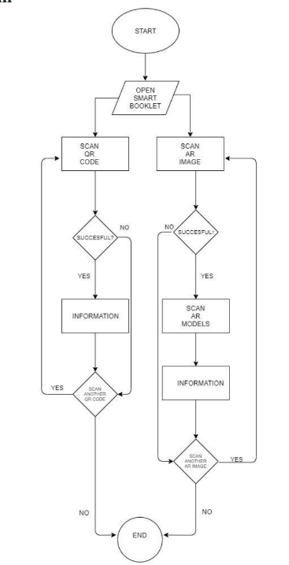
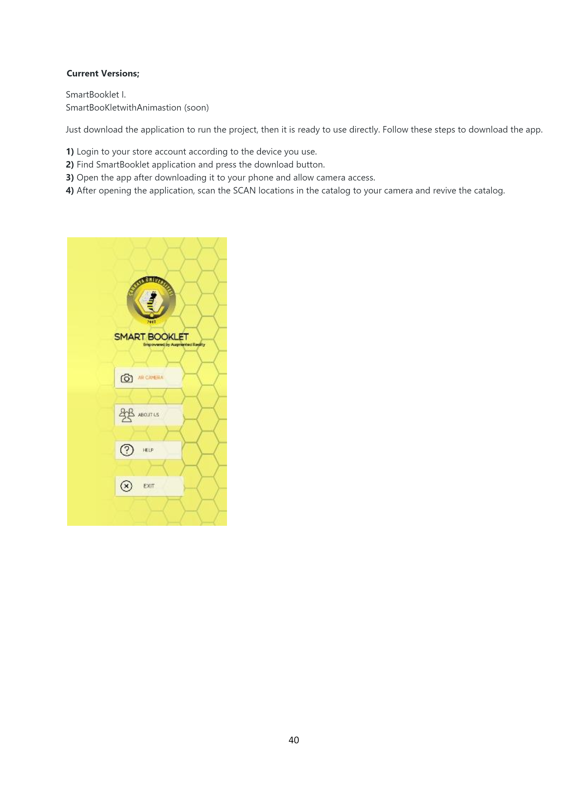
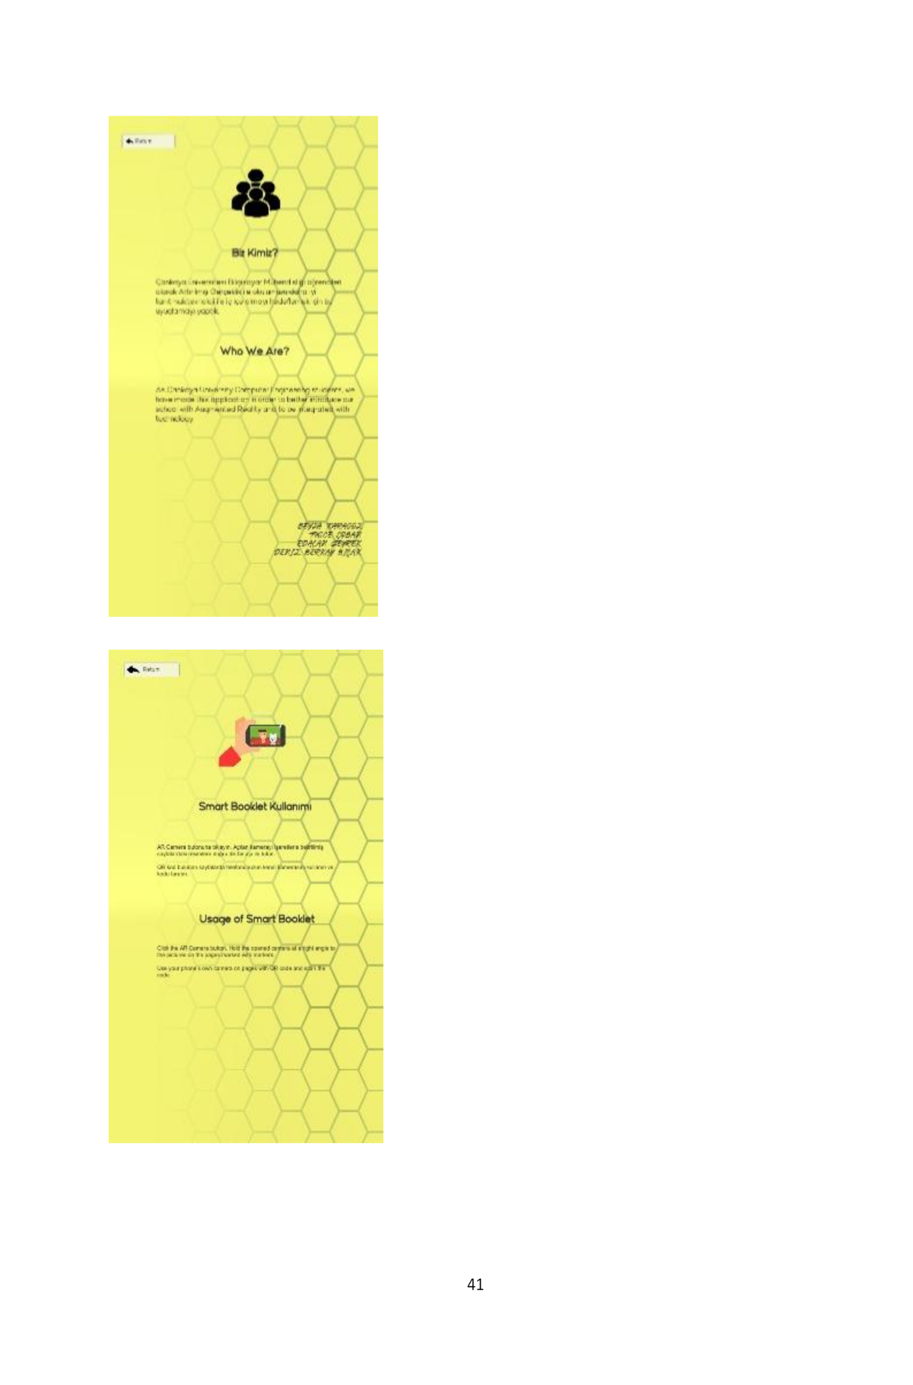
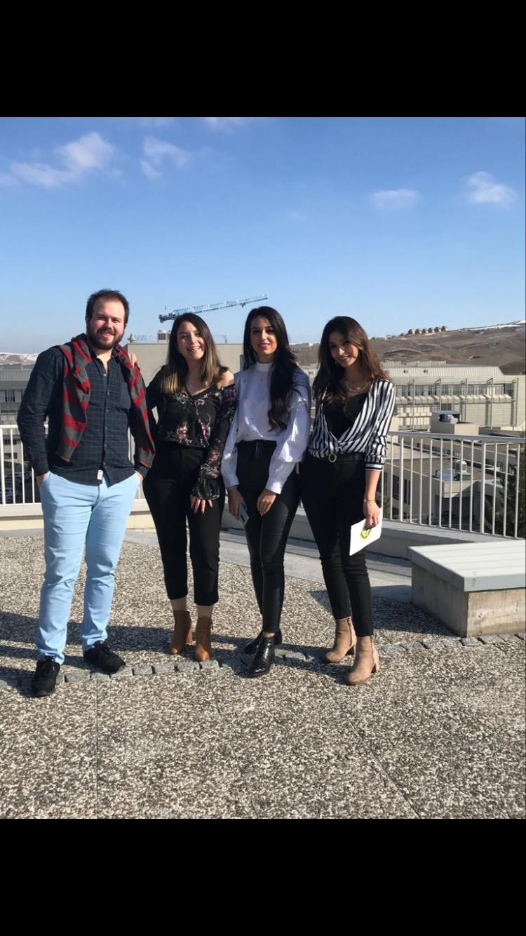
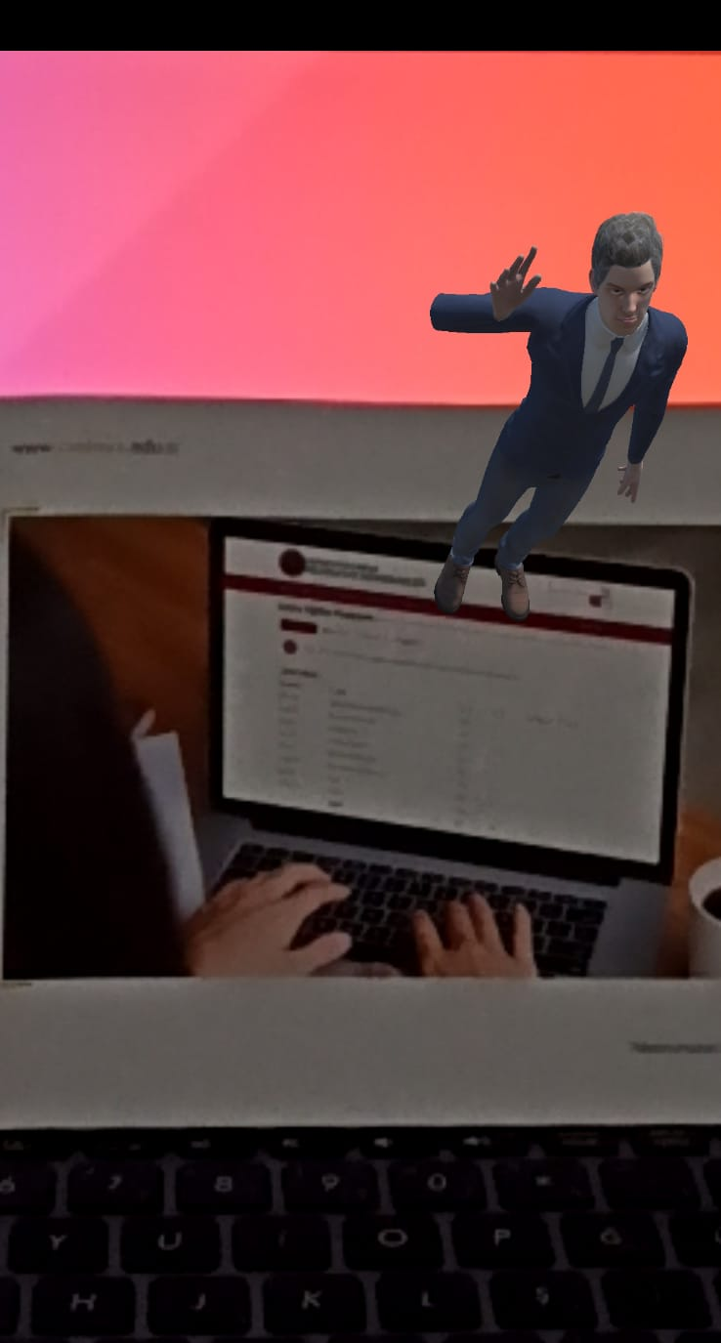
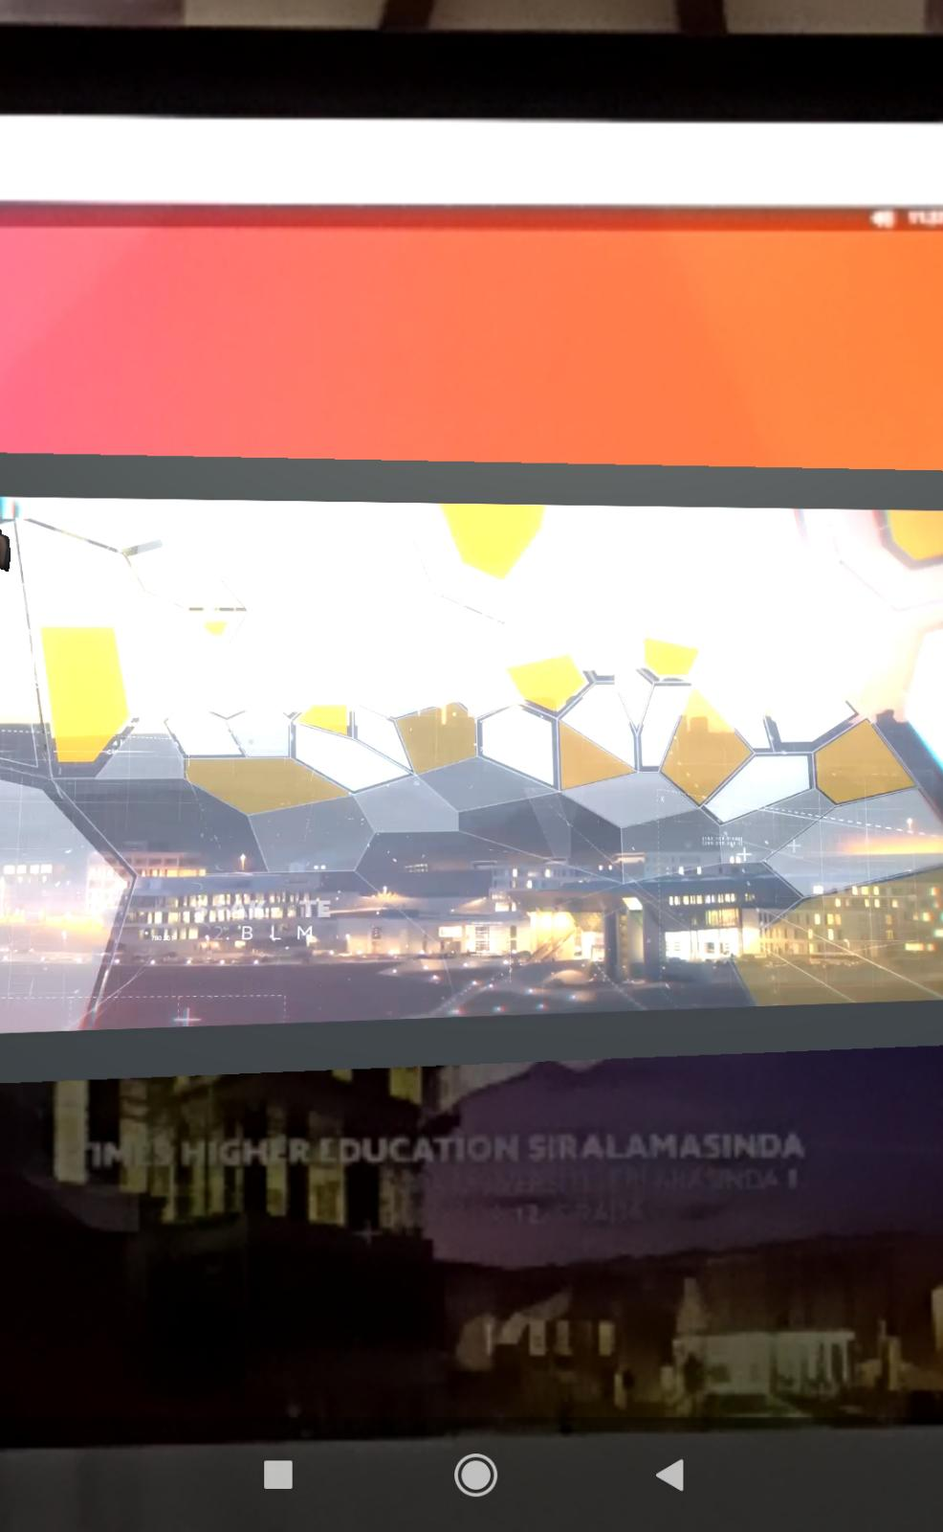
Smart Booklet Empowered by Augmented Reality
Edacan SEYREK– Deniz Berkay BIÇAK
Tuğçe ÇOBAN-Beyza KARAGÖZ
Advisor: Öğr. Gör. Dr. Faris Serdar TAŞEL
Çankaya University, Department of Computer Engineering
Abstract
Augmented reality is one of today's most popular topics. It is a technology that can be easily used as long as you have access to the Internet and the necessary applications. Augmented reality makes 3D feel like we are in a virtual universe. To date, traditional catalogs have only provided information in simple form in pictures and text. For this reason, with the catalog we will create using the augmented reality in our project, users can get information about all the content in the most realistic and detailed way. By scaning images and reading the QR codes in the catalog, data such as photos, videos, maps and links are easily accessible.
Keywords:Augmented reality, smart booklet,QR code,smart phones.
Results & Conclusion
Augmented reality has become a technology we encounter in every aspect of our lives. QR code is a visual technology that helps people with easy information flow, facilitating transactions and fast access. By combining these two technologies, we aim to promote our department in the best way. We will create a smart booklet with the most detailed and realistic information about our school and our department will have. With the researches and articles we have made, we have learned how to use the methods and programs in our project.
Figure 1 – Activity Diagram
Introduction
We aim to provide more realistic and detailed content by using qr codes in our catalog created with augmented reality. People can access all the information about our department in detail using
our catalog. Our catalog aims to provide detailed information in many areas such as general publicity, laboratories, academic staff, curriculum, student community, students, news and communication. In order to present our department in a detailed and realistic way, we provide access to various media data such as photos, videos, maps, links by using qr code and scaning images.
We use augmented reality technology, in order to show people our labs in the most realistic way, we offer 360 degree visualization, video and photo data for academic staff, links for viewing the curriculum, maps etc.
Acknowledgement
We are happy to do our project with the advisor of Öğr. Gör. Dr. Faris Serdar TAŞEL.Thanks for the help we have received from him, we will improve ourselves and our project.
Solution
In our project, we present our catalog to the user with augmented reality using the unity and vuforia library. We designed it as an application for easy use from phones and tablets. The pictures in the catalog can be accessed by using cameras from the phones with internet connection, and animations and videos. We chose to use QR code for the information we want to be presented. The assistant we designed as an animation provides general information about our school to the user..
Figure 3 – Finished Product
Figure 7– Project Members

